Slide 1
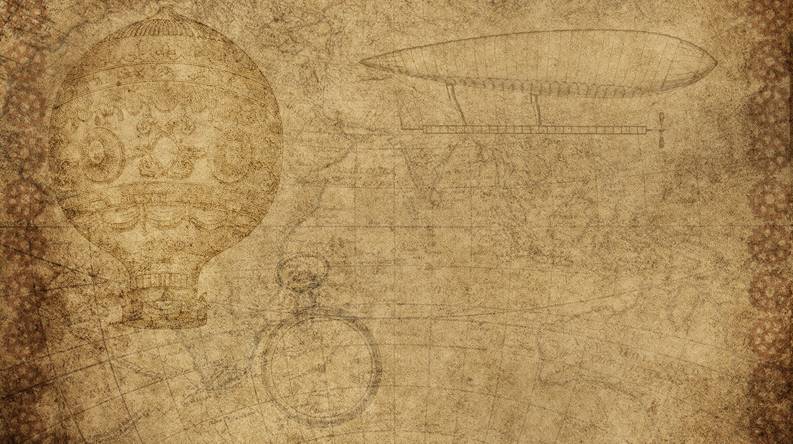

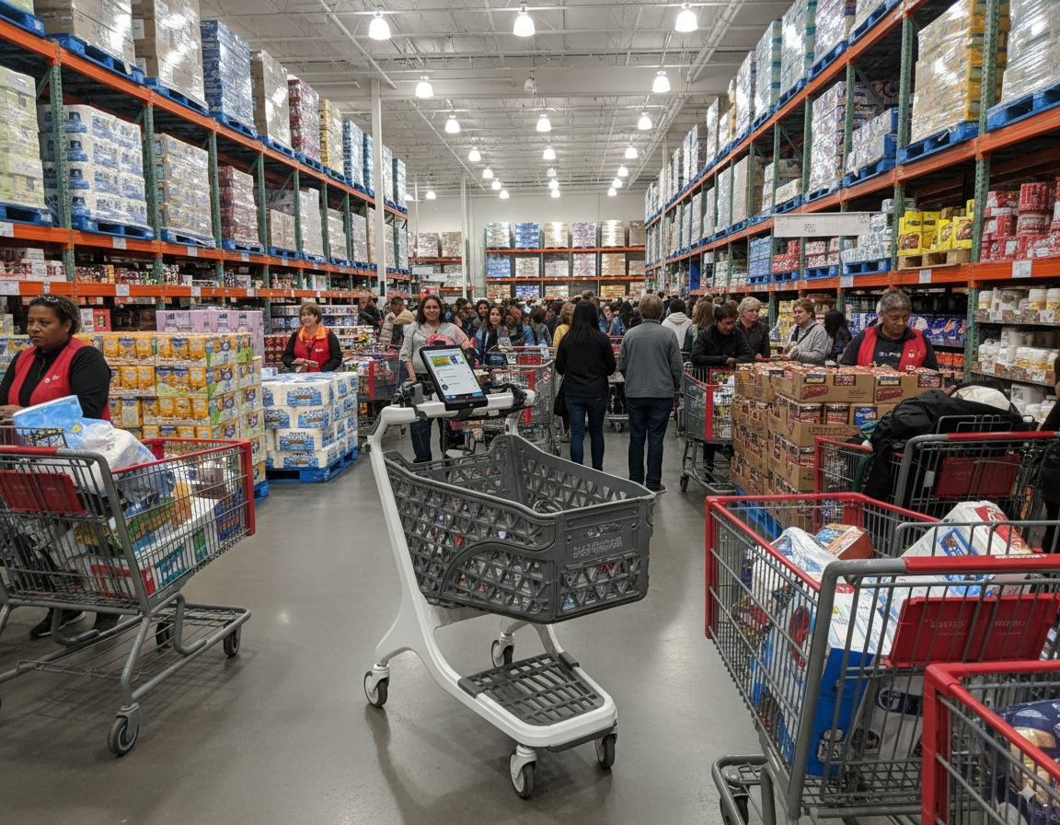
Franc Chariot
Intelligent Autonomous Shopping Cart Prepared by: Franck Kolontchang Houston Community College | October 2025

Slide 2

WHY THIS InventioN
After experiencing a very long line in a shop to buy goods.
Seeing abandoned cards all over town. Probably due to theft.
Heavy goods are complicated to check out
Difficulties for disabled customers to do their shopping
Good customer service- goods accessibility. No agent needed
More income for store owners
Help non-English speakers

Slide 3

Mission and VISION
Mission: Make shopping effortless, inclusive, and intelligent. Vision: Deploy 10,000 Franc Chariots by 2030 to revolutionize global retail.

Slide 4

Problem and oPPORTUNITY
Long checkout lines → 32% of customers leave stores
High labor costs = 40–60% savings
Cart theft = $800M lost annually
Only 200–300 stores globally use smart carts → massive opportunity

Slide 5

The Franc Chariot Solutions
Automatic product recognition + real-time checkout
Navigation assistance & personalized recommendations
Family & accessibility features (voice guidance)
Anti-theft GPS tracking and wheel locks
<Insert pictures or drawings of your invention design/building process>
*you can insert a new slide for these pictures/drawings if you need to!

Slide 6

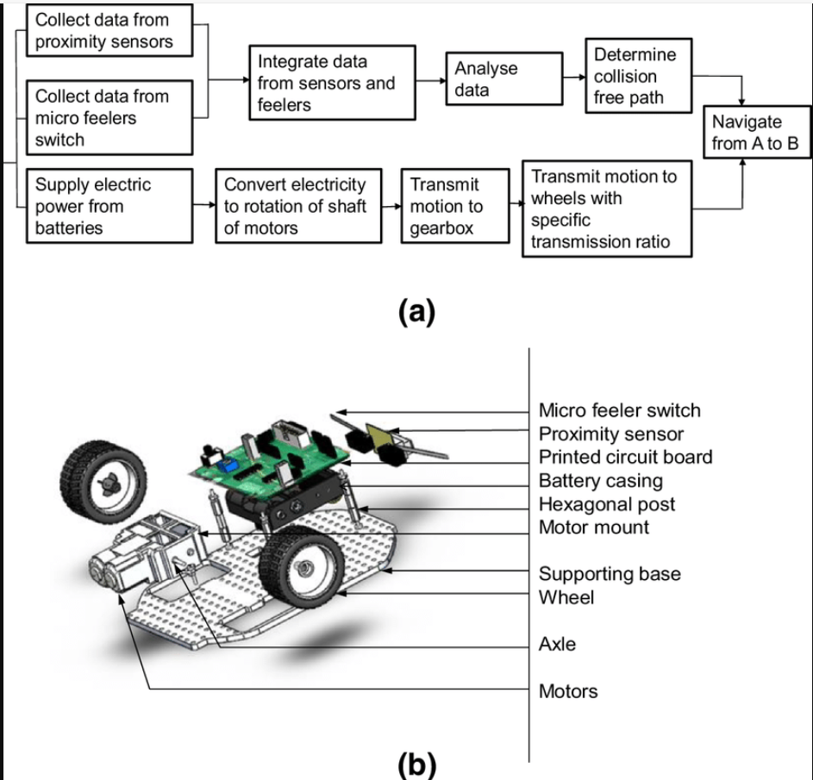

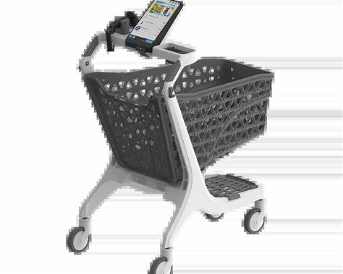
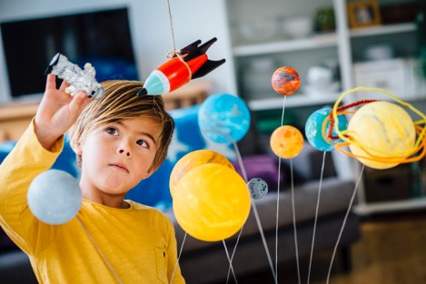

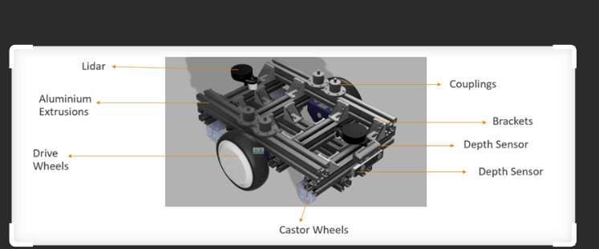
My Invention in Use!
Talk about how people reacted to your invention
Franc Chariot will solve a lot of difficulties in the retail business.
It will Help Clients, employees, employers, and owners.
<Insert pictures or drawings of your invention being used, with a description entered here>
*you can insert a new slide for these pictures/drawings if you need to!
<Insert pictures or drawings of your invention being used, with a description entered here>
*you can insert a new slide for these pictures/drawings if you need to!
<Insert pictures or drawings of your invention being used, with a description entered here>
*you can insert a new slide for these pictures/drawings if you need to!

Slide 7
Unique Value Proposition
50–70% lower cost ($2700–$3,200) Family-friendly design with Accessibility for the elderly & disabled App (optional) –tap your cart Local Houston presence & service

Slide 8
Market Opportunity
U.S. Market: 100,000+ grocery stores (20–25 M carts)
Houston Envi: 2,168 stores = $65M–$108M 5-year value
30% Compound Annual Growth Rate through 2030

Slide 9
COMPETITIVE ANALYSIS
1-Franc Chariot |self-driving| scans products|voice recognition (“hey Francky”), | manages payments|
2-Amazon Dash |Assisted | scans products| manages payments
3-Caper AI| |Assisted | scans products| manages payments
4-Veeve’s information not revealed.

Slide 10
Technology Overview
AI/ML (Detectron2, YOLOv8) for product recognition
LiDAR & ultrasonic sensors for navigation
Voice & touch interface for all users
Powered battery (8–12 hrs runtime)
Computer vision-Pixel

Slide 11
Financial Highlights (5 Years)
Year | Units | Revenue | Gross Profit
1 | 4,000 | $6 M | $1.6 M
2 | 10,000 | $15 M | $4.5 M
3 | 20,000 | $30 M | $10.5 M
5 | 40,000 | $60 M | $25.5 M

Slide 12
– Funding Request ($2.5 - 3 M Seed)
Use of Funds:
Product Development – 26%
Manufacturing – 20%
Inventory & Materials – 16%
Marketing & Sales – 14%
Operations – 12%
Personnel – 8%
Working Capital – 4%
Break-even: 18–24 months | IRR: 35–45%

Slide 13
– Implementation Timeline
Month 6: Prototype + first pilot
Month 12: 5 pilot stores
Month 18: 20 stores, $6 M run rate
Month 24: Break-even + Series A readiness

Slide 14
-Risk & Mitigation
Tech failures: Robust testing & QA(Quality Assurance)
Competition: Cost leadership + accessibility focus
Funding: Hybrid revenue model (leasing + per use)
Adoption: Pilot with local chains for trust & visibility

Slide 15
-Closing & Call to Action
“We’re not inventing a new market — we’re making it accessible and profitable.” Let’s build the future of shopping — together. 📧 [kolontchangfranck@gmail.com]
🌐 www.francchariot.com in creation.

